Slide 1
Max Pos
Pos system for fashion shop

Slide 2
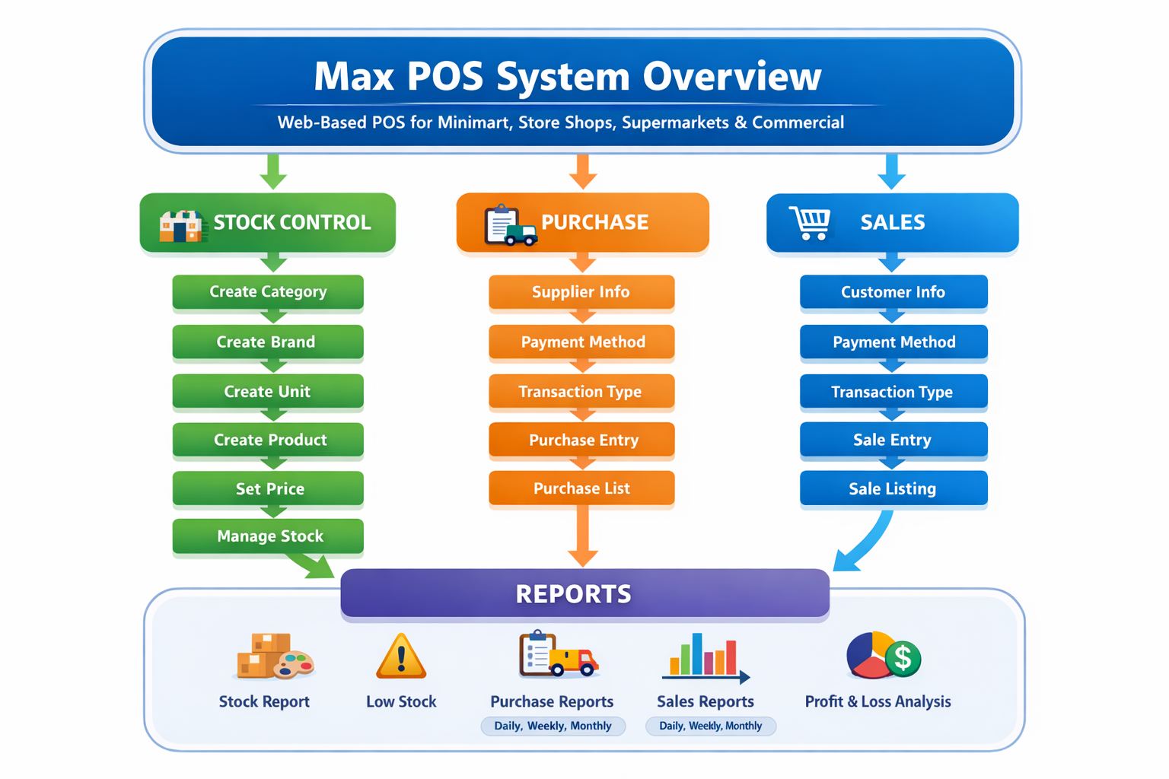
System Overview

Slide 3
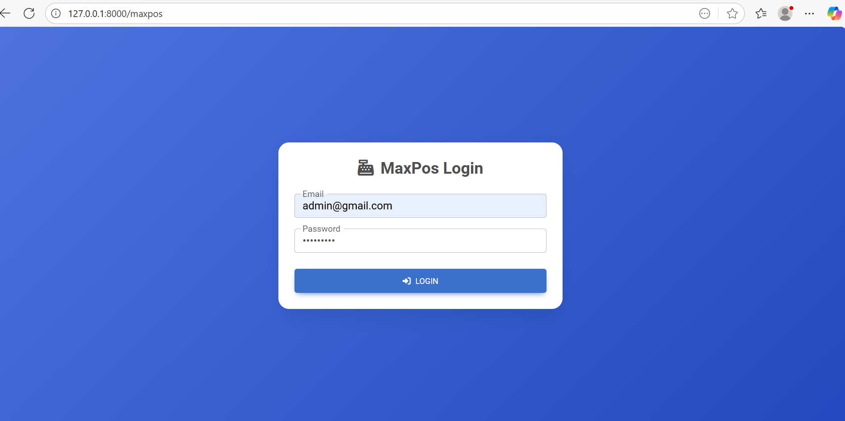
Login Page

Slide 4
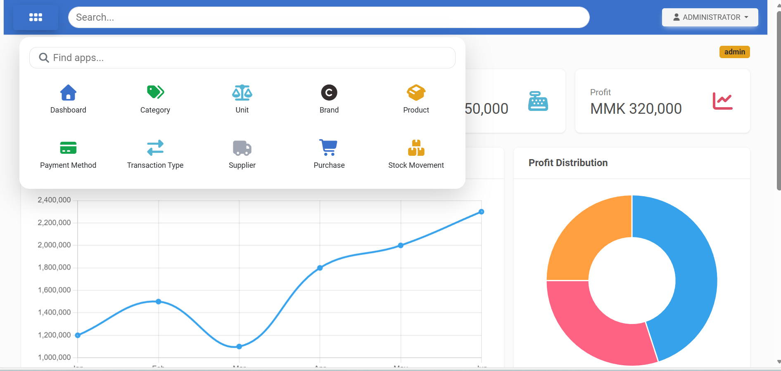
Home Page with menu bar

Slide 5
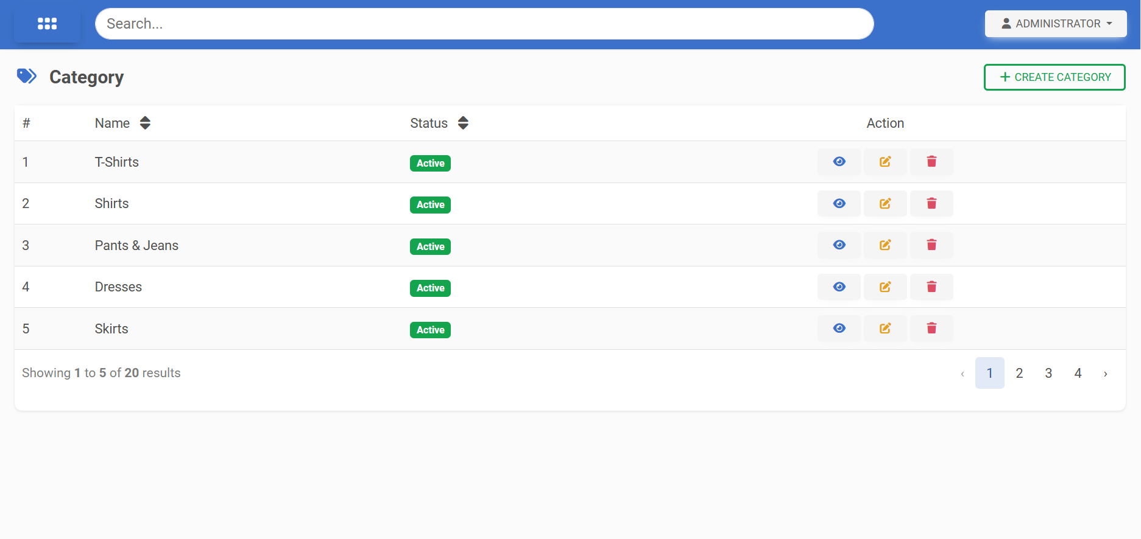
Category List Page

Slide 6
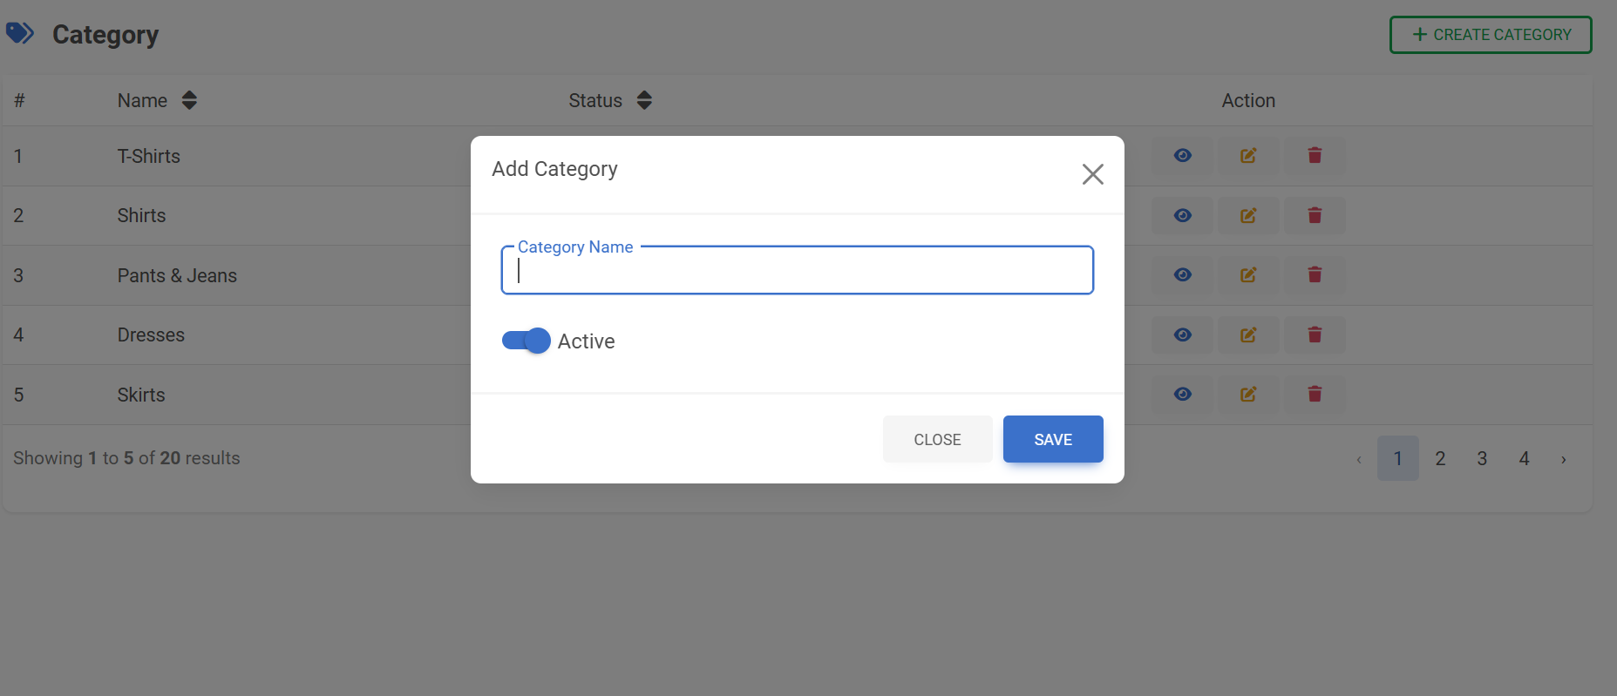
Category Add Page

Slide 7
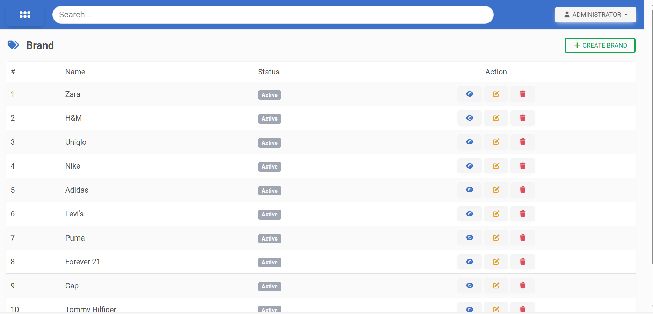
Brand Page

Slide 8
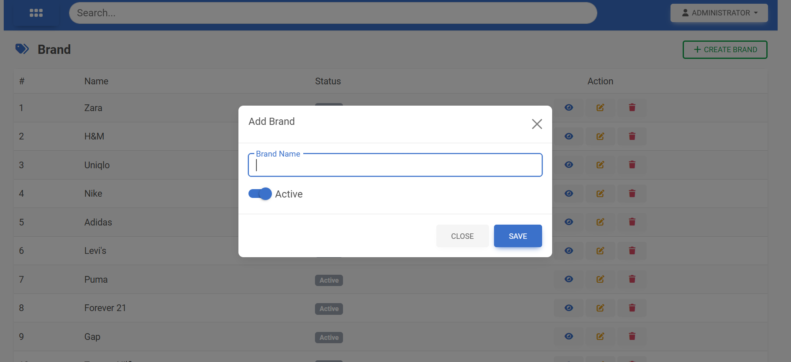
Brand Add Page

Slide 9
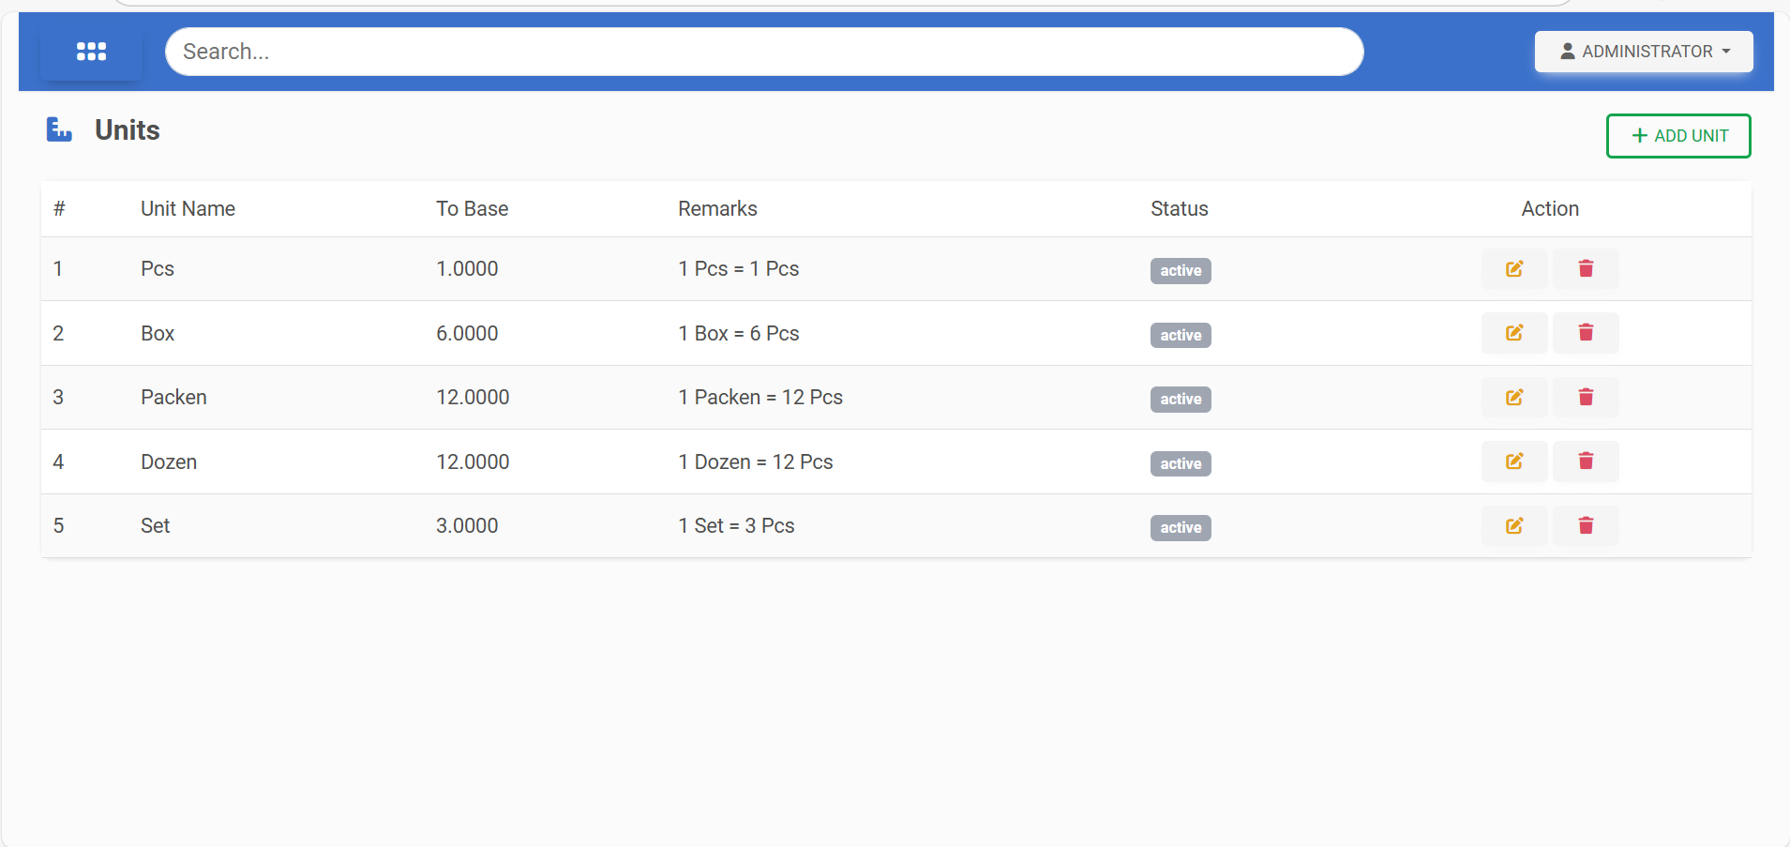
Unit Page

Slide 10
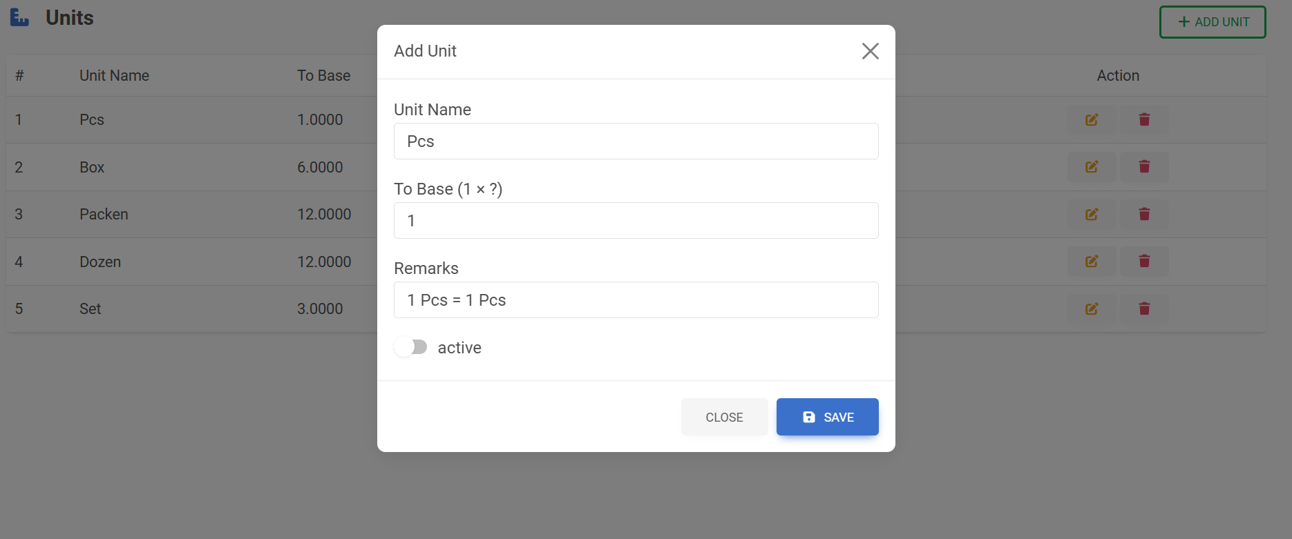
Unit Add Page/ Edit Page

Slide 11
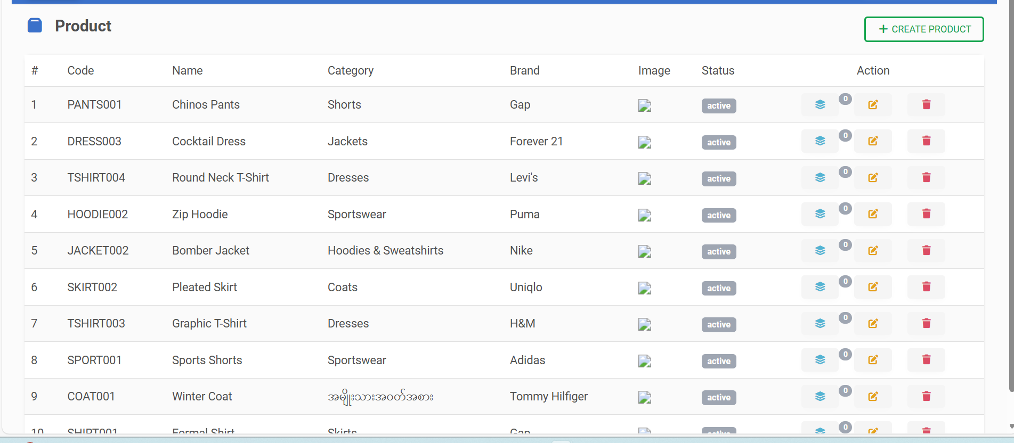
Product Page

Slide 12
Brand Page

Slide 13
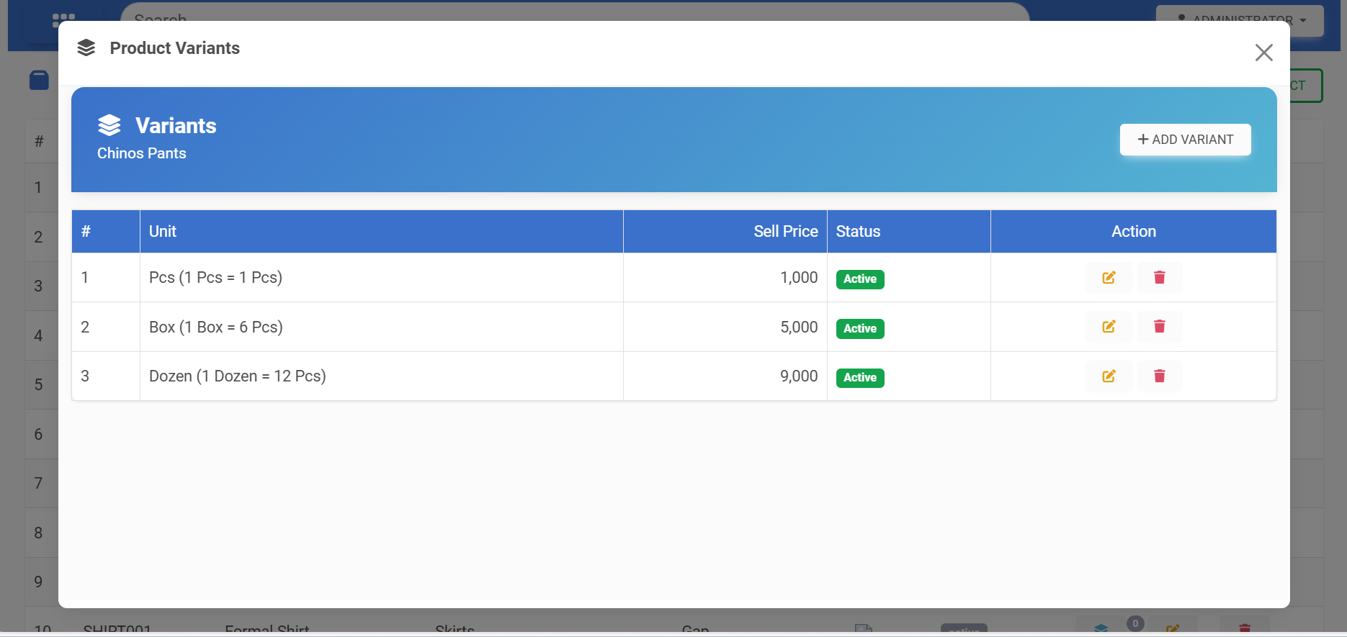
Product Variant Page

Slide 14
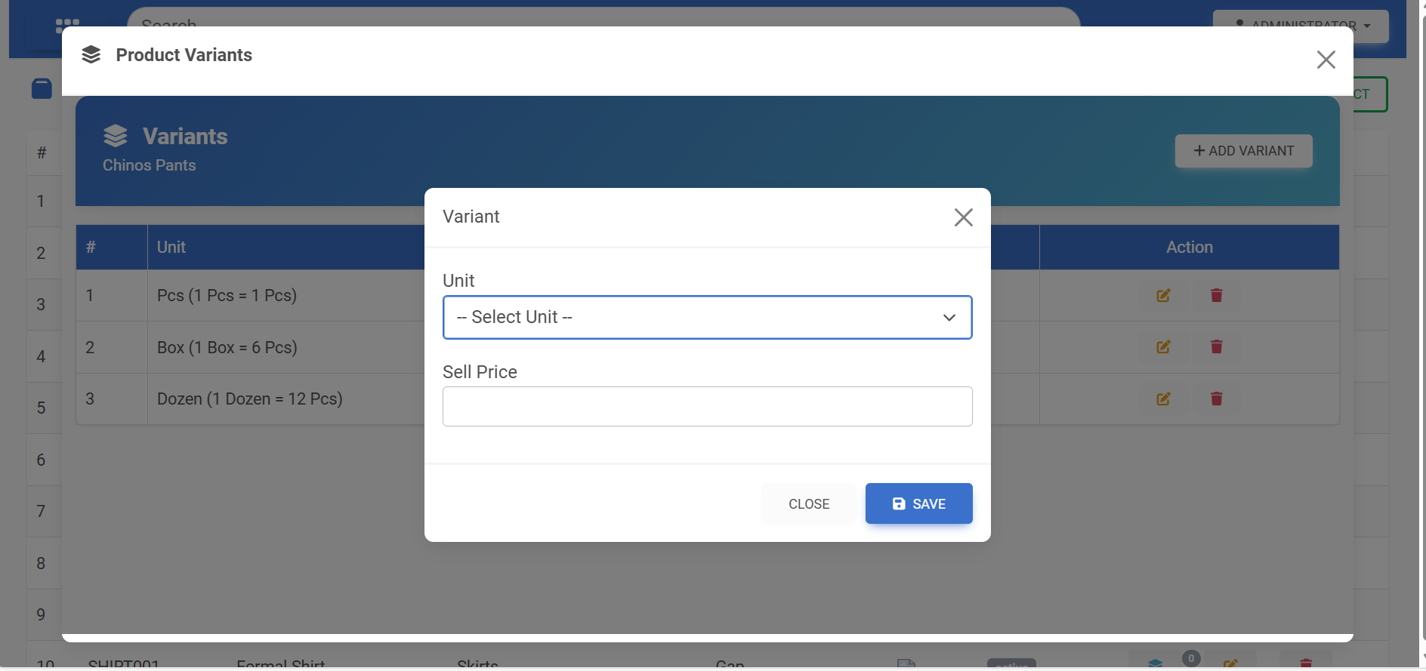
Product Variant Add Form

Slide 15
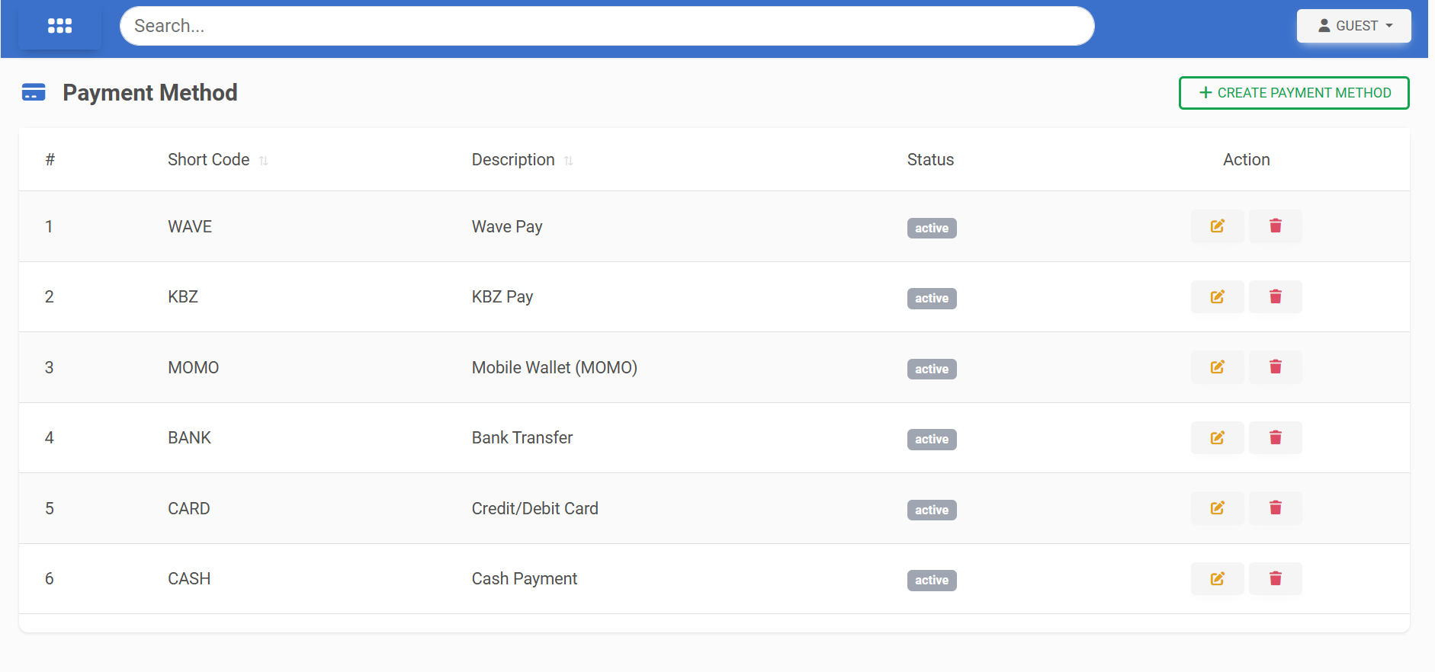
Payment Method Page

Slide 16
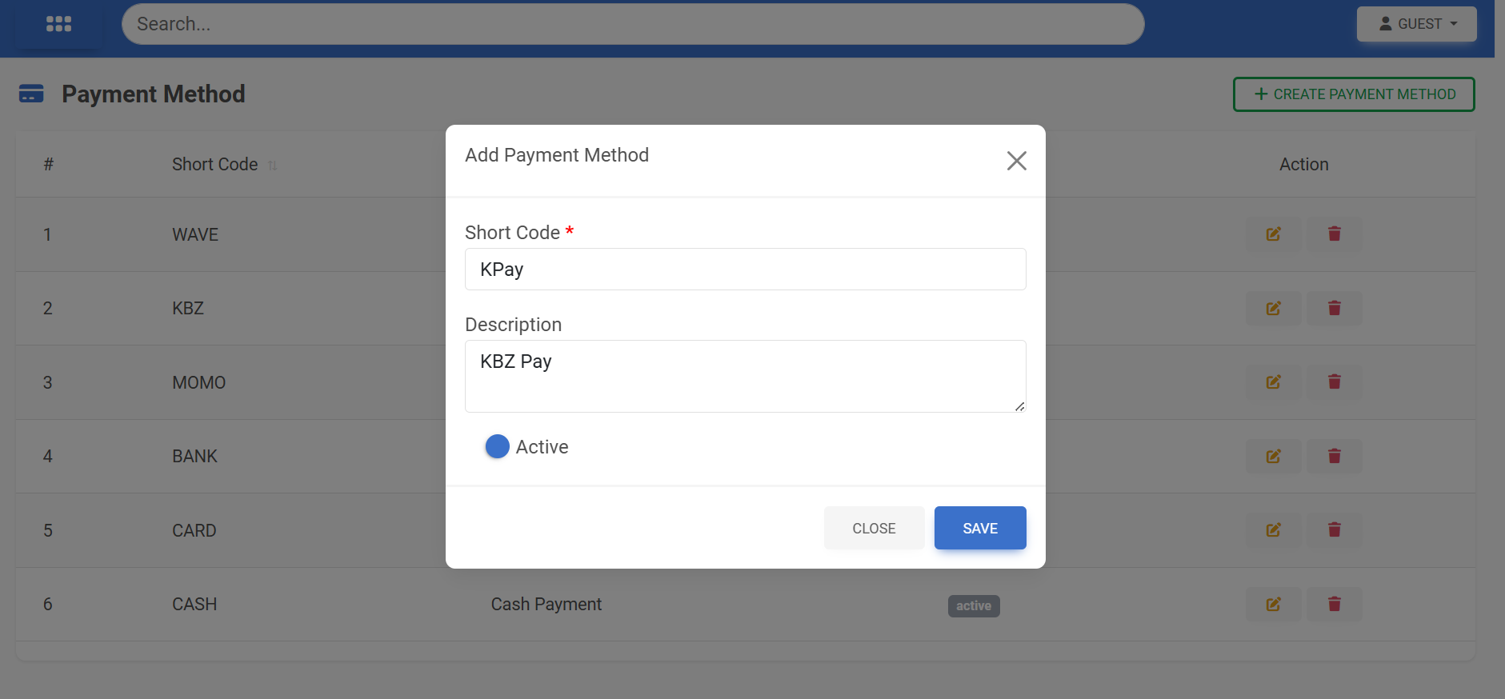
Payment Method Page

Slide 17
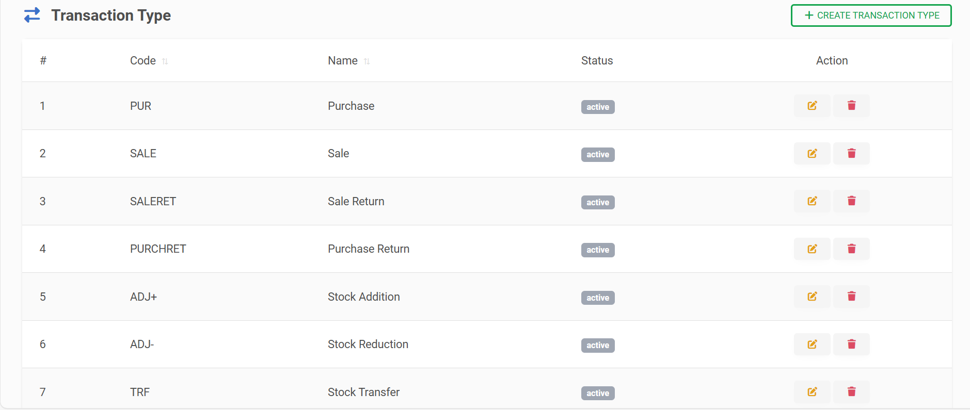
Transaction Page

Slide 18
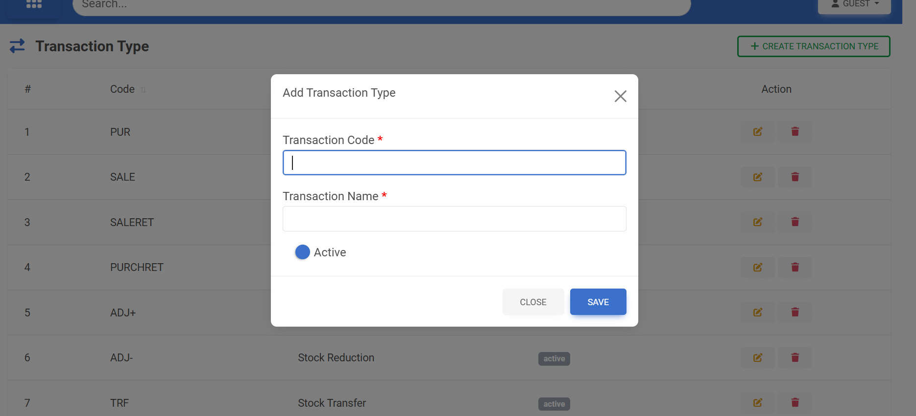
Transaction Add Page

Slide 19
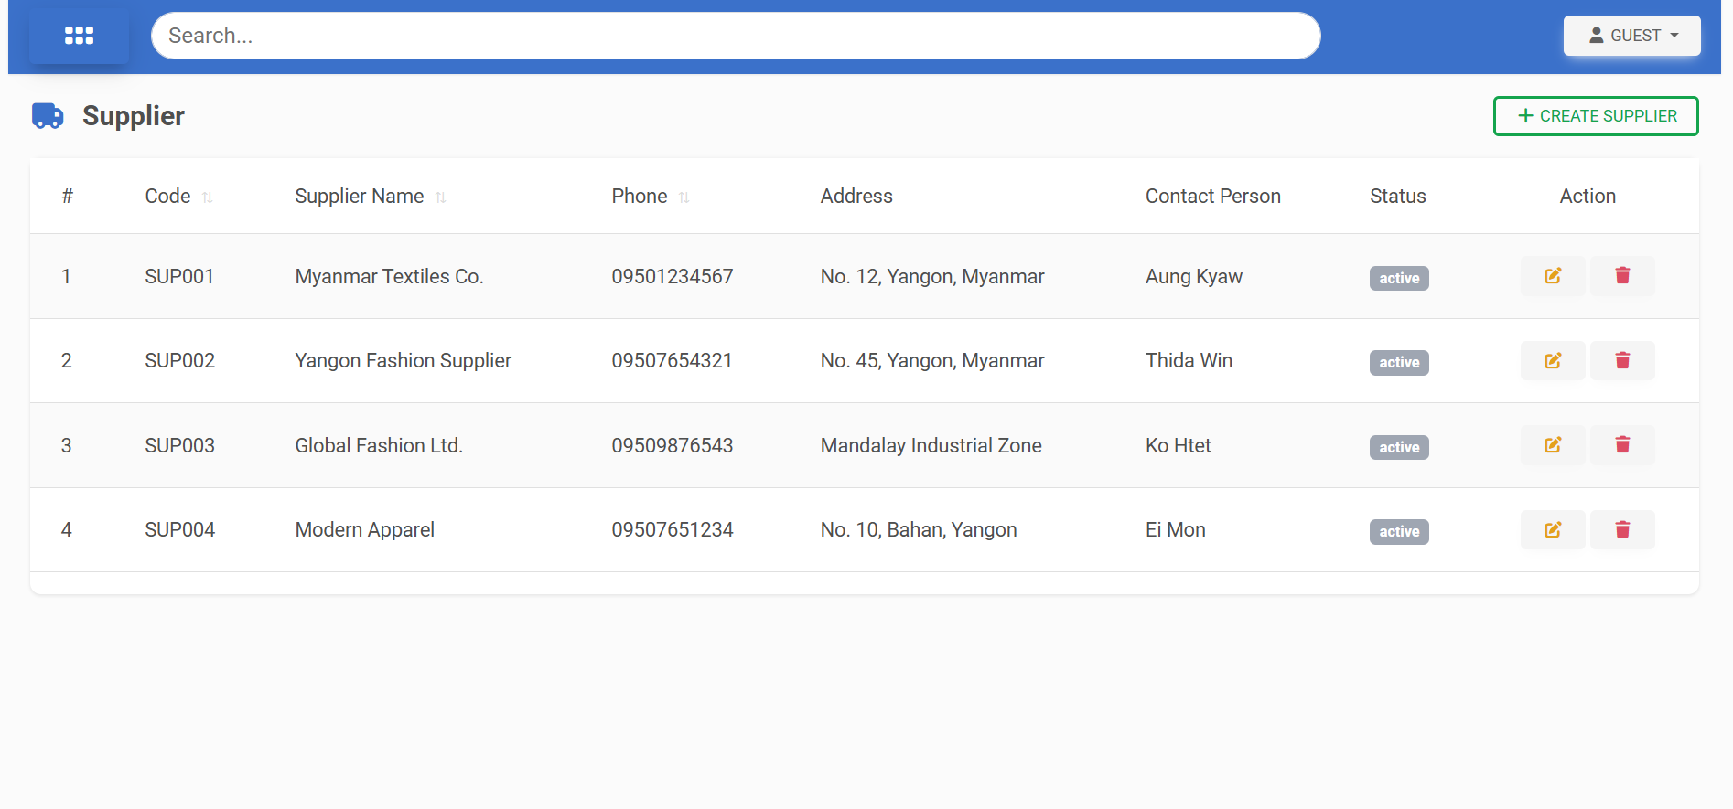
Supplier Page

Slide 20
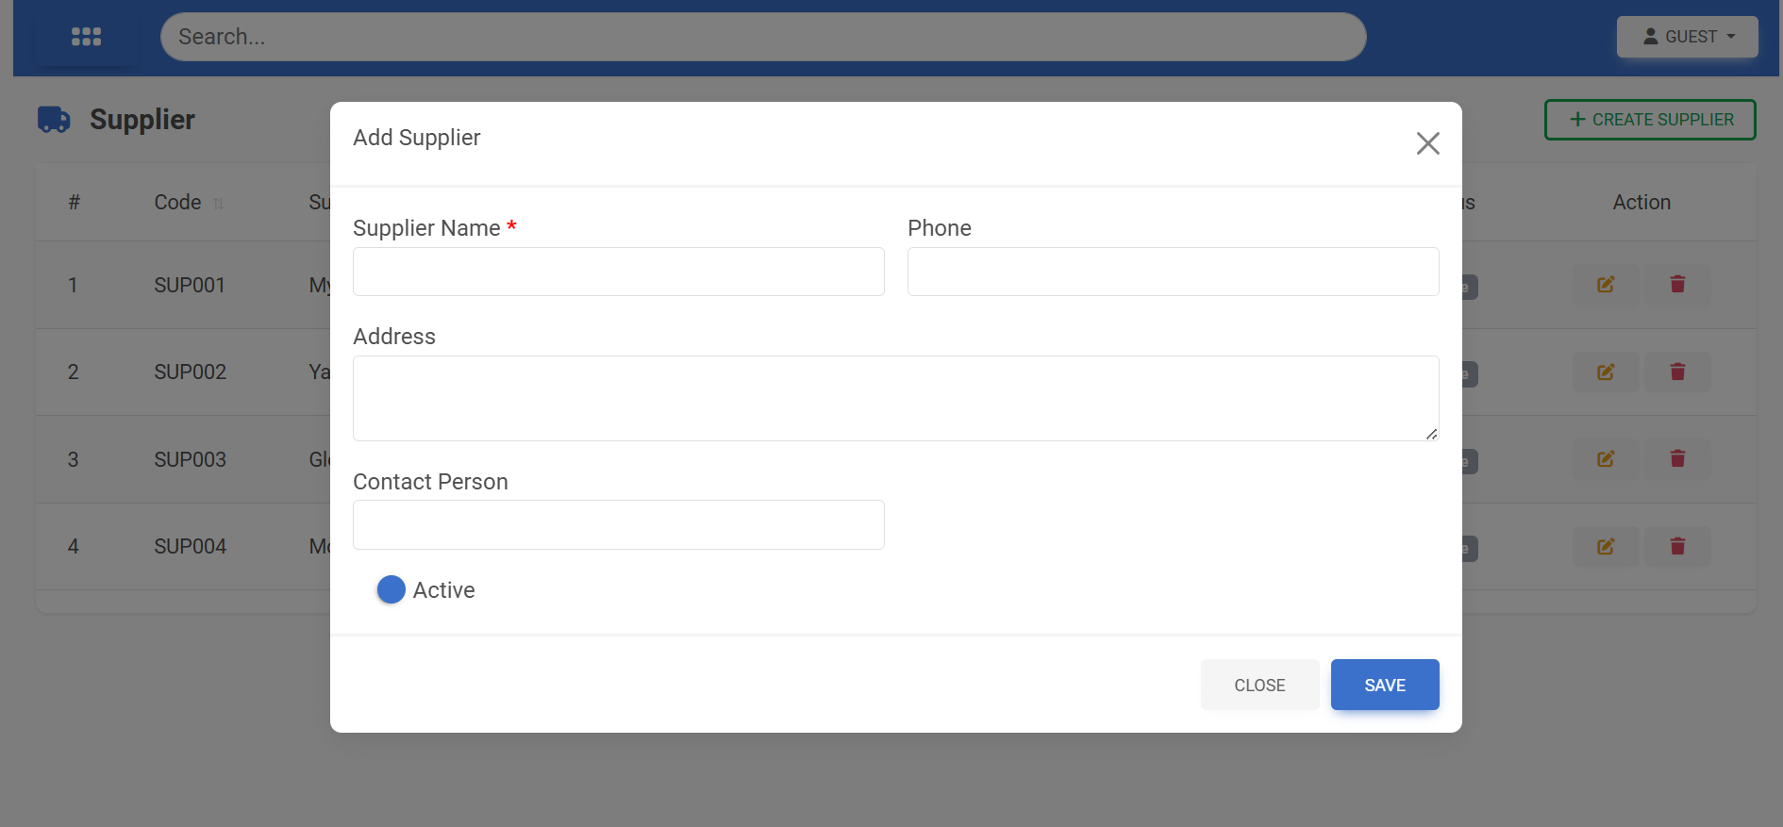
Supplier Add Page

Slide 21
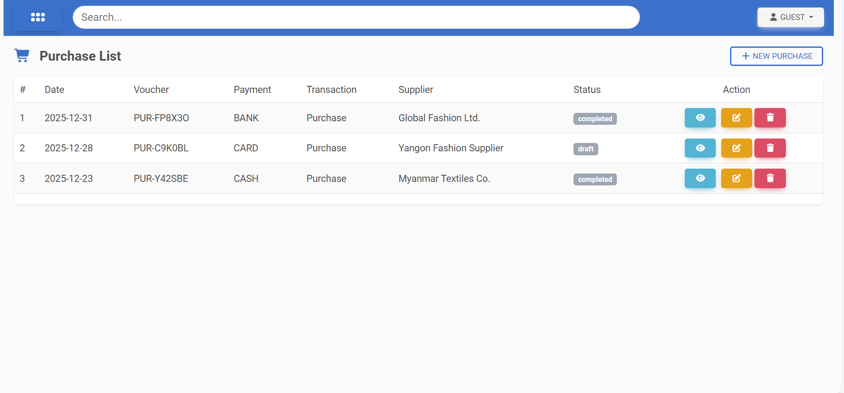
Purchase List

Slide 22
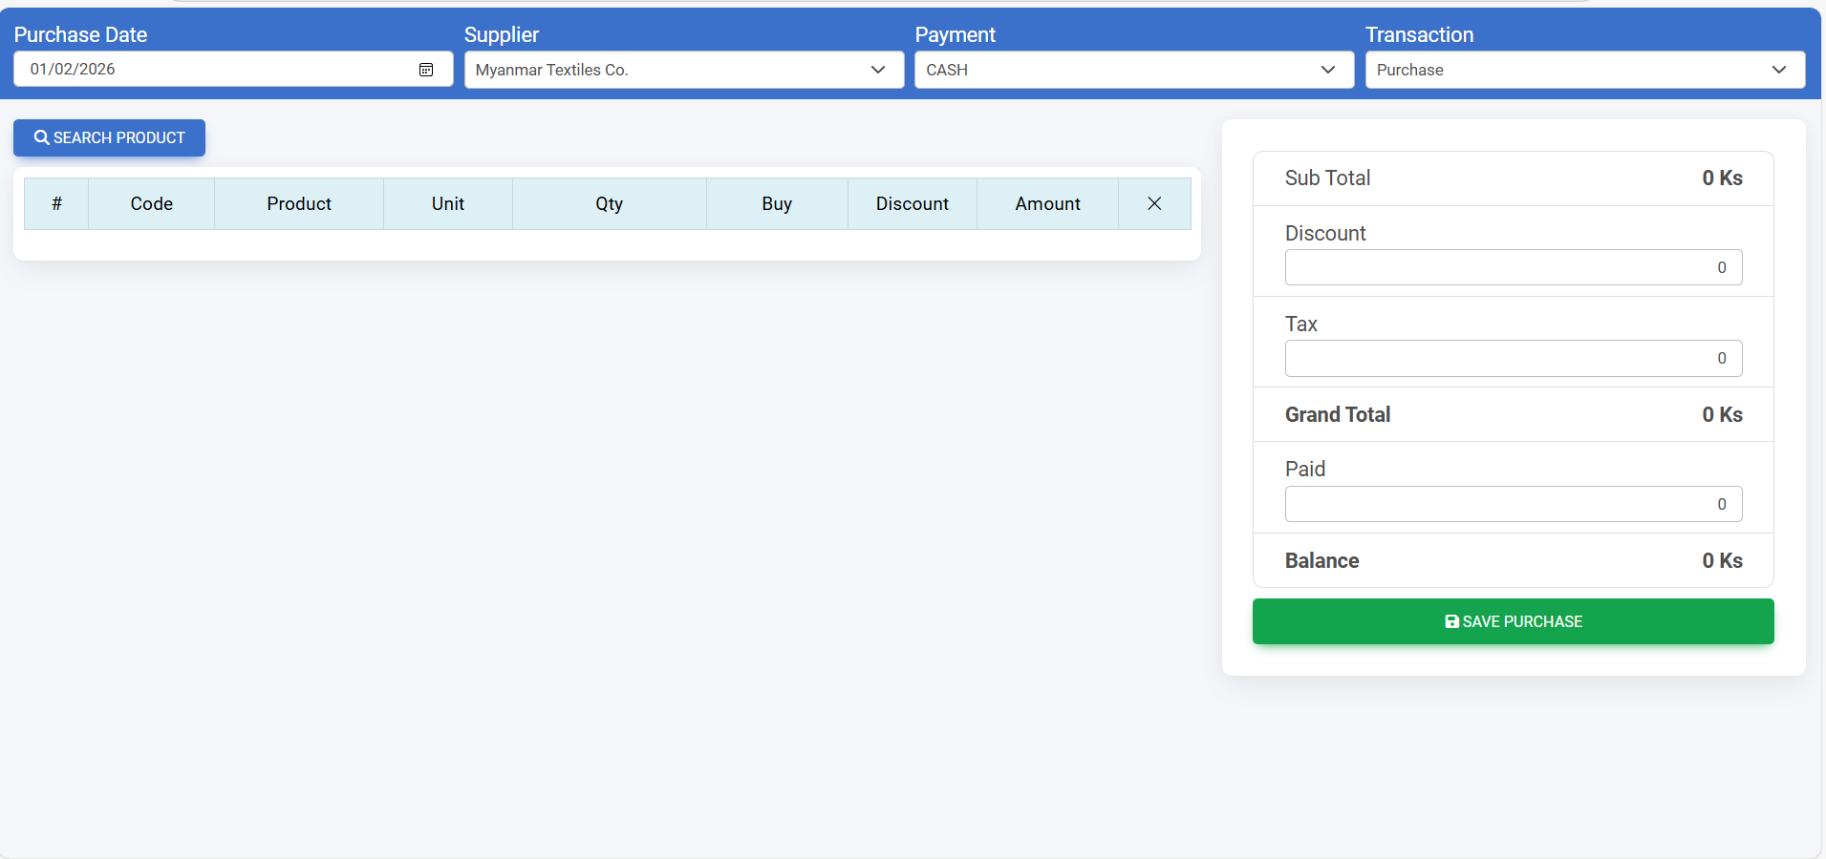
Purchase Add Page

Slide 23
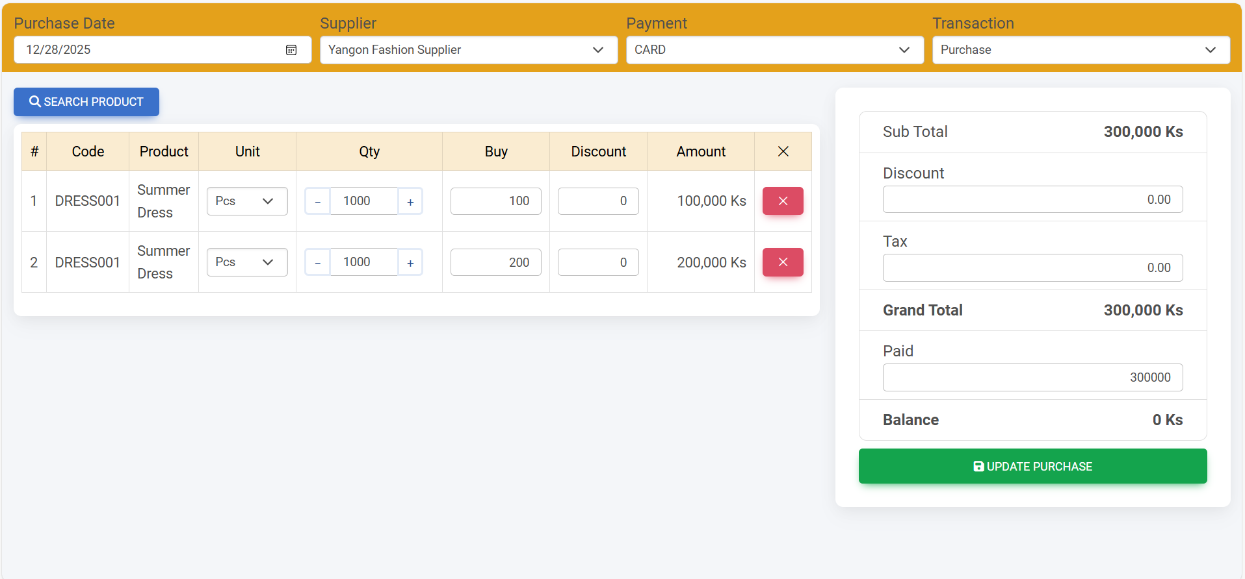
Purchase Add Page

Slide 24
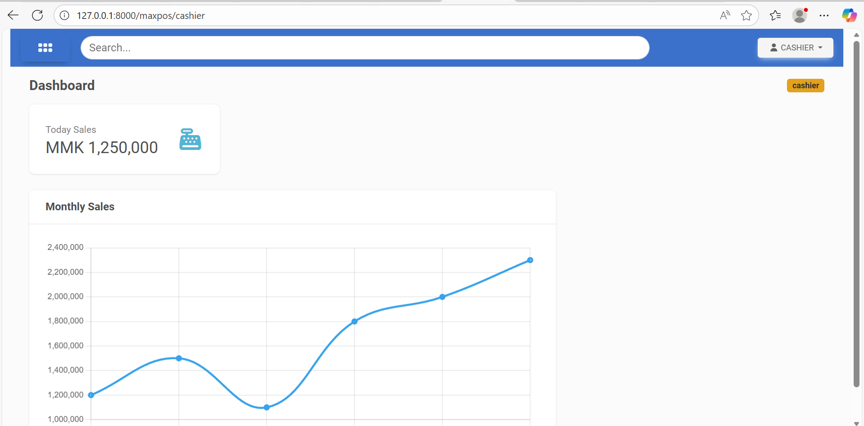
Sale Page – Cashier Role View

Slide 25
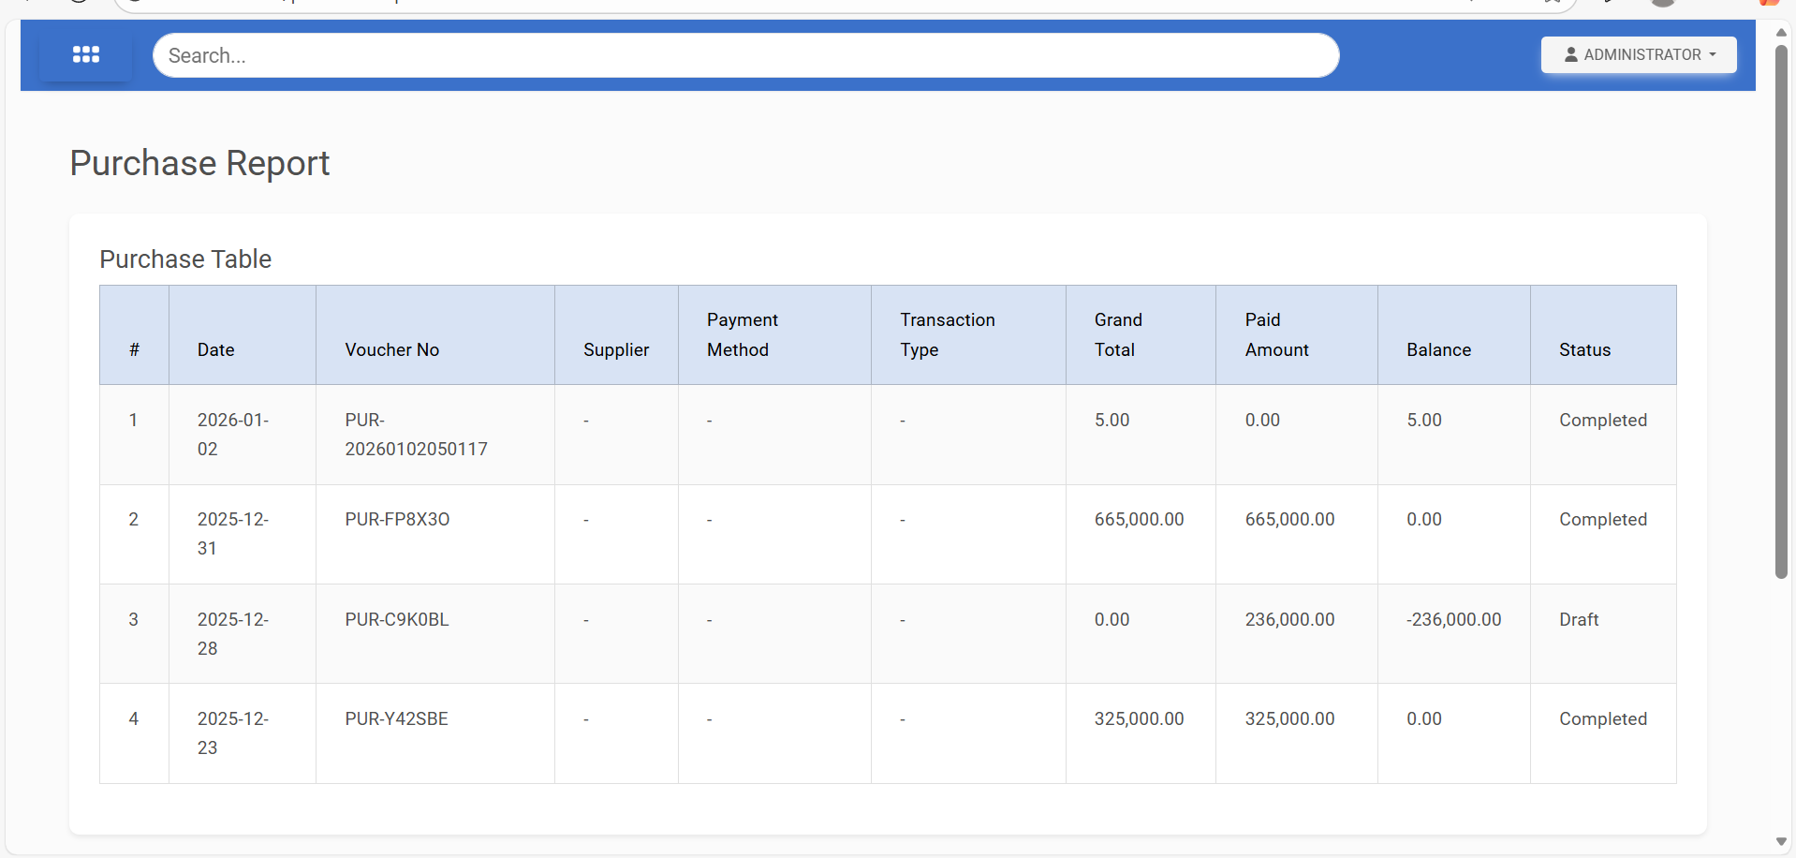
Purchase Report

Slide 26
Transaction Add Page

